Slide 1
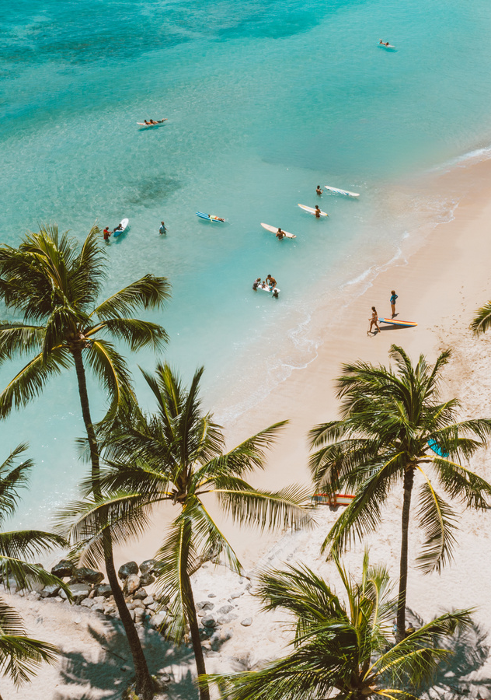


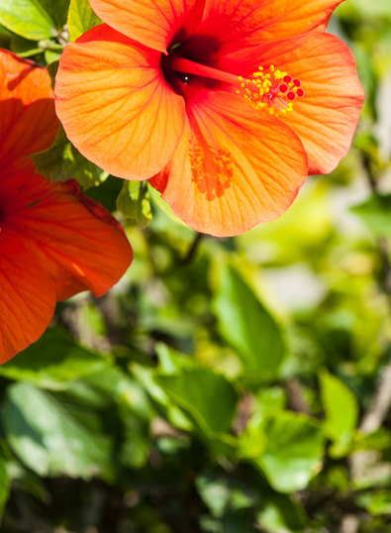

ISMRM & ISMRT ANNUAL MEETING & EXHIBITION
Honolulu, Hawai’i, USA
10-15 May 2025
Welcome to your first ISMRM
What you can expect and how to make your meeting a success
STAY CONNECTED DURING THE MEETING:

Slide 2
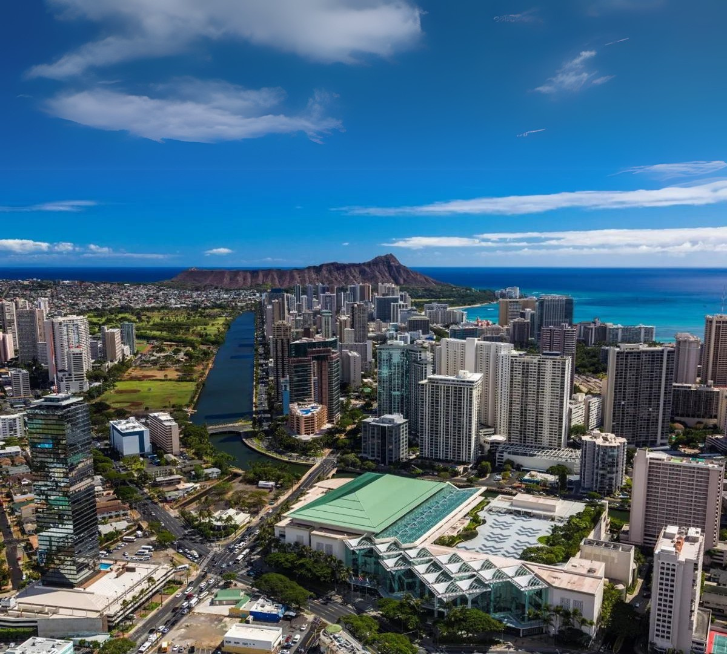

Towards a Healthier
Footprint
ISMRM & ISMRT
ANNUAL MEETING & EXHIBITION
10-15 MAY 2025
Honolulu, Hawai’i, USA

Slide 3
ISMRM & ISMRT ANNUAL MEETING & EXHIBITION
Honolulu, Hawai’i, USA
10-15 May 2025
What can you expect?
Over 6000 Attendees from over 40 countries
432 Presentations (75 Educational Sessions, 357 Scientific Sessions)
81 Scientific-Oral Sessions (comprised of 769 abstracts)
32 Power Pitch Sessions (comprised of 645 abstracts)
220 Digital Poster Sessions (comprised of 3426 abstracts)
24 Traditional Poster Sessions (comprised of 307 abstracts
(Numbers from Singapore 2024)
STAY CONNECTED DURING THE MEETING:

Slide 4
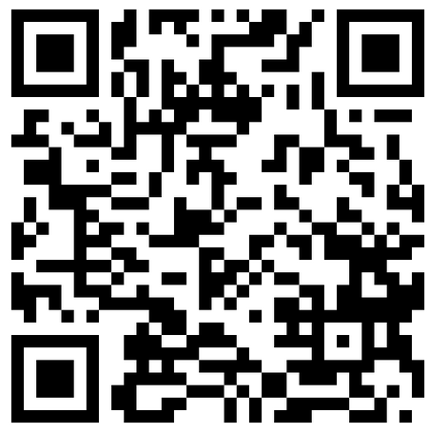
ISMRM & ISMRT ANNUAL MEETING & EXHIBITION
Honolulu, Hawai’i, USA
10-15 May 2025
What can you do at the conference?
Educational Sessions
Plenary Sessions
Oral Sessions
Power Pitches
Traditional and Digital Posters
Study Groups
Special sessions:
Mentoring
Reviewer Training
You find the program here:
https://www.ismrm.org/25/25program.htm
STAY CONNECTED DURING THE MEETING:

Slide 5
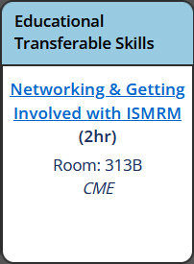
ISMRM & ISMRT ANNUAL MEETING & EXHIBITION
Honolulu, Hawai’i, USA
10-15 May 2025
What you should not miss on Saturday
Saturday
13:00-15:00
STAY CONNECTED DURING THE MEETING:

Slide 6


ISMRM
Newbie
Reception
SATURDAY, 10 MAY 2025
17:15-19:00 | Room 311
STAY CONNECTED DURING THE MEETING:

Slide 7


ISMRM & ISMRT ANNUAL MEETING & EXHIBITION
Honolulu, Hawai’i, USA
10-15 May 2025
Newbie
Reception
it‘s not in the program
The event just for you
Meet MR Experts from various backgrounds
Neuro
Oncology
MR Hardware
„Ask me anything“
etc.
!!RSVP required!!
Bring your badge and your
#1 Ribbon
Room 311
STAY CONNECTED DURING THE MEETING:

Slide 8
ISMRM & ISMRT ANNUAL MEETING & EXHIBITION
Honolulu, Hawai’i, USA
10-15 May 2025
Newbie
Reception
You receive:
Food and one complimentary drink
The opportunity to get in touch with the Experts
Meet the (Past) President(s)
Networking and Communication opportunities
We ask you to:
Proactively approach the Experts
Use this time and space to get to know the people
and the conference
Ask anything you want to know
HAVE FUN
STAY CONNECTED DURING THE MEETING:

Slide 9

ISMRM & ISMRT ANNUAL MEETING & EXHIBITION
Honolulu, Hawai’i, USA
10-15 May 2025
Newbie
Reception
How you imagine it will be
STAY CONNECTED DURING THE MEETING:

Slide 10

ISMRM & ISMRT ANNUAL MEETING & EXHIBITION
Honolulu, Hawai’i, USA
10-15 May 2025
Newbie
Reception
How it actually is
STAY CONNECTED DURING THE MEETING:

Slide 11
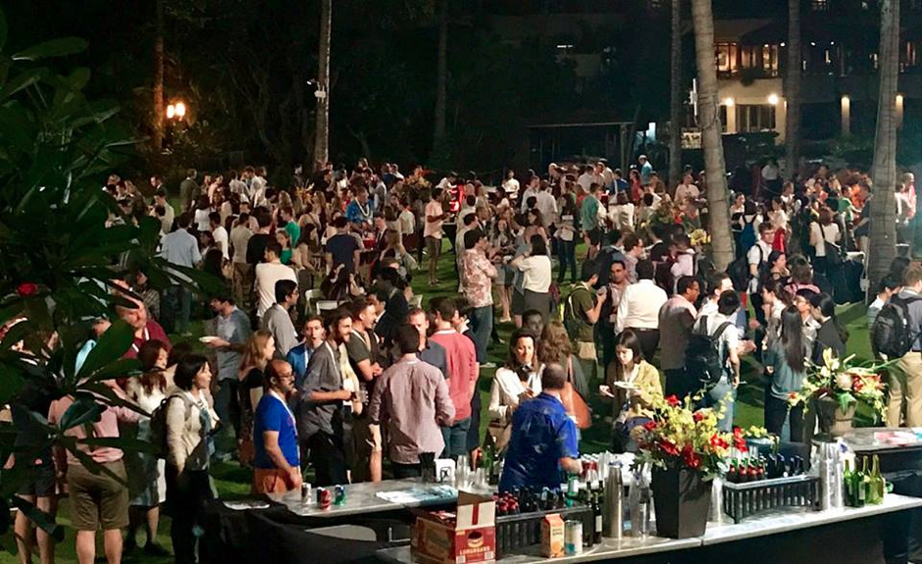
ISMRM & ISMRT ANNUAL MEETING & EXHIBITION
Honolulu, Hawai’i, USA
10-15 May 2025
How it actually was in 2017
Diary of a Newbie: What I learned from the ISMRM Newbie Reception
BY ATEF BADJI
STAY CONNECTED DURING THE MEETING:

Slide 12
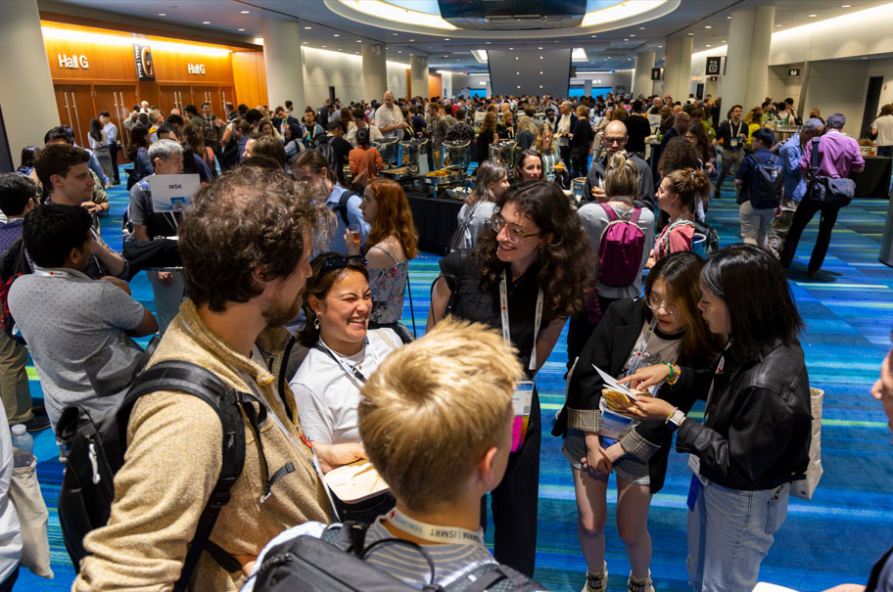

ISMRM & ISMRT ANNUAL MEETING & EXHIBITION
Honolulu, Hawai’i, USA
10-15 May 2025
How it actually was in Toronto 2023
STAY CONNECTED DURING THE MEETING:

Slide 13
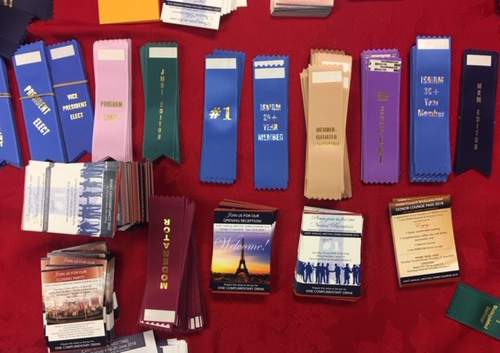
ISMRM & ISMRT ANNUAL MEETING & EXHIBITION
Honolulu, Hawai’i, USA
10-15 May 2025
Newbie
Reception
Break the ice
ISMRM Chapters
ISMRM Study Groups
Anything about your common field and interests
How to navigate the conference (Must do‘s/must sees)
Mentoring opportunities
How to get in touch with the ISMRM
What do these badges mean?
DO NOT BE SHY – THE MR EXPERTS ARE HERE FOR
>>>YOU<<<
STAY CONNECTED DURING THE MEETING:

Slide 14
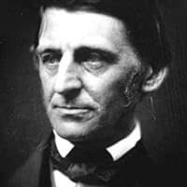
ISMRM & ISMRT ANNUAL MEETING & EXHIBITION
Honolulu, Hawai’i, USA
10-15 May 2025
Newbie
Reception
“In my walks, every [person] I meet is my superior in some way, and in that I learn from [them].”
― Ralph Waldo Emerson (1803 – 1882)
STAY CONNECTED DURING THE MEETING:

Slide 15

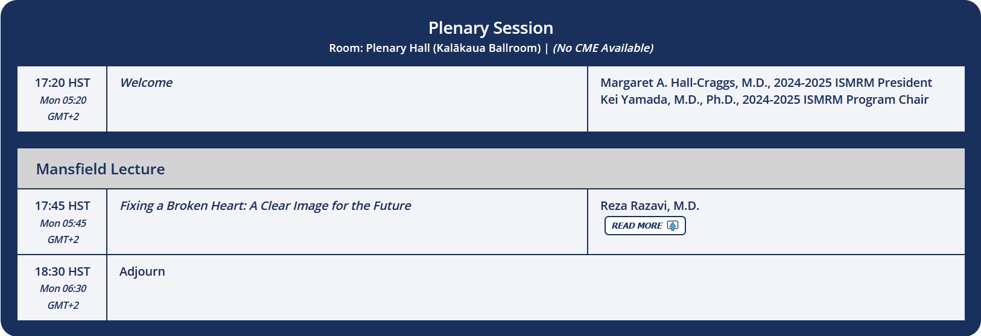

ISMRM & ISMRT ANNUAL MEETING & EXHIBITION
Honolulu, Hawai’i, USA
10-15 May 2025
What you should not miss on Sunday
12:00-13:00
17:20-18:30
18:30-20:00
STAY CONNECTED DURING THE MEETING:

Slide 16
ISMRM & ISMRT ANNUAL MEETING & EXHIBITION
Honolulu, Hawai’i, USA
10-15 May 2025
Gold Corporate Symposium?
Sunday – Thursday
Industry sponsored events (No CME)
„Lunch“ Symposium
You receive a ticket for a lunch box upon leaving after the session
STAY CONNECTED DURING THE MEETING:

Slide 17
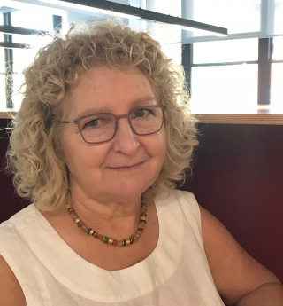
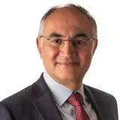
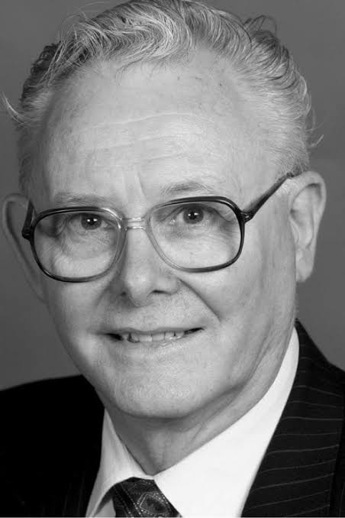
ISMRM & ISMRT ANNUAL MEETING & EXHIBITION
Honolulu, Hawai’i, USA
10-15 May 2025
Plenary Session and Mansfield Lecture
Official opening of the conference by the ISMRM President Margaret Hall-Craggs
Mansfield Lecture by Reza Rasavi
There are multiple Plenary sessions throughout the week
Margaret Hall-Craggs
Reza Rasavi
Sir Peter Mansfield (†)
STAY CONNECTED DURING THE MEETING:

Slide 18










ISMRM & ISMRT ANNUAL MEETING & EXHIBITION
Opening
Reception
SUNDAY, 11 MAY 2025
18:30-20:00 | Kamehameha Exhibit Hall
STAY CONNECTED DURING THE MEETING:

Slide 19
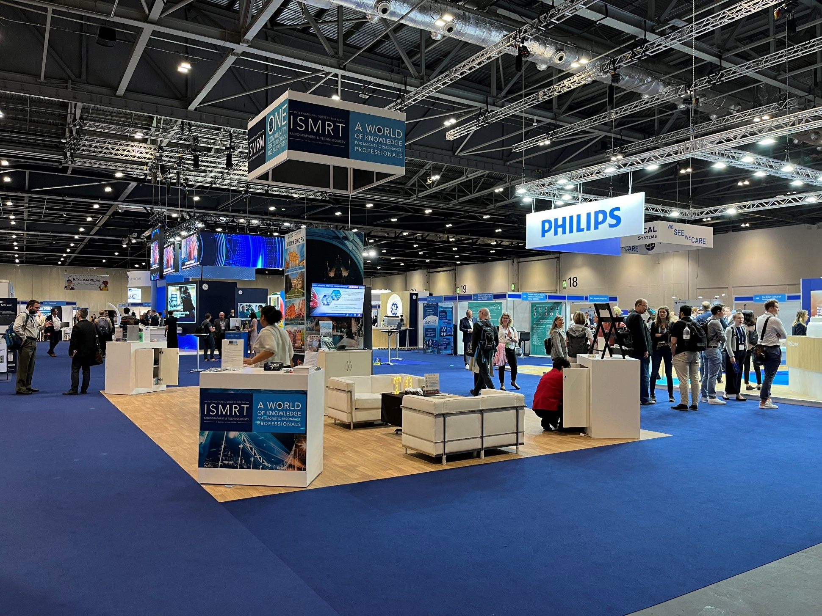
ISMRM & ISMRT ANNUAL MEETING & EXHIBITION
Honolulu, Hawai’i, USA
10-15 May 2025
Opening Reception
After the Mansfield Lecture in the Exhibition Hall
Official Opening of the industry exhibition
Food and one complimentary drink
Meet people, meet the industry, get to know each other
ALOHA
STAY CONNECTED DURING THE MEETING:

Slide 20
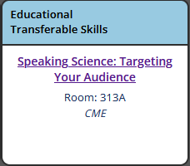
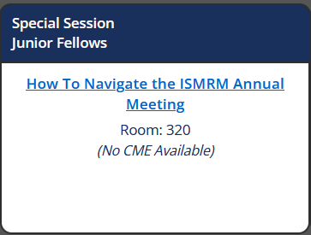
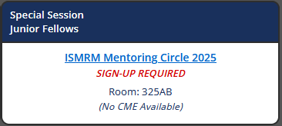

ISMRM & ISMRT ANNUAL MEETING & EXHIBITION
Honolulu, Hawai’i, USA
10-15 May 2025
It is not all party and food
Sunrise Sessions
Monday, Tuesday, Wednesday
7:00-8:00
Monday
8:15-10:15
Thursday
13:15-15:15
STAY CONNECTED DURING THE MEETING:

Slide 21
ISMRM & ISMRT ANNUAL MEETING & EXHIBITION
Honolulu, Hawai’i, USA
10-15 May 2025
How to make the meeting a success
Browse the Program and the Abstracts in advance to plan the sessions you want to attend
Note the times of the (Digital) poster presentation to get in touch with the presenters
Focus on scientific sessions in your field of expertise
Take the opportunity for discussions at posters
Don’t overdo it - You can only take in so much
STAY CONNECTED DURING THE MEETING:

Slide 22

ISMRM & ISMRT ANNUAL MEETING & EXHIBITION
Honolulu, Hawai’i, USA
10-15 May 2025
What else can you do?
Stop by at the ISMRM booth (Exhibition hall)
Get in touch with the industry
Ask the “MR Experts” you meet for advice
Use the spare time you have for networking
Don’t shy away from approaching your idols - Most will be more than happy to help you
Reach out to potential collaborators before the conference to set up a meeting later
ALOHA
STAY CONNECTED DURING THE MEETING:

Slide 23
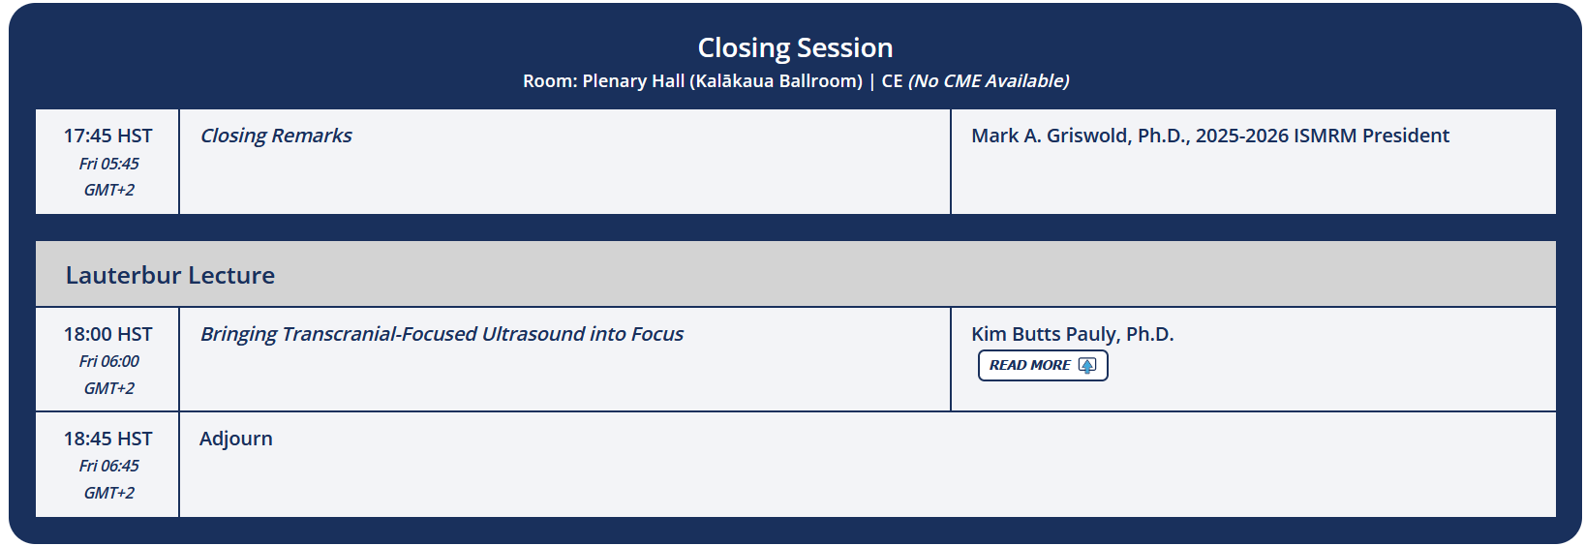
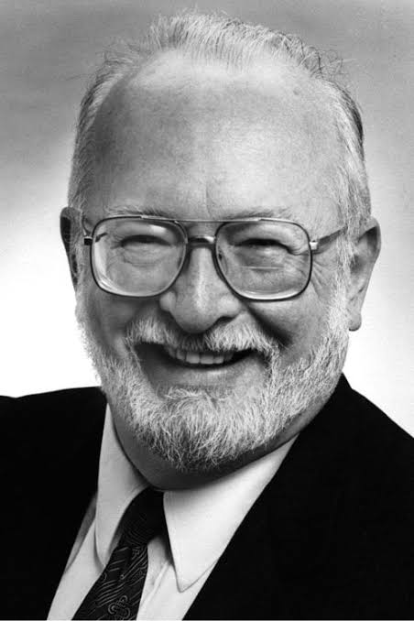
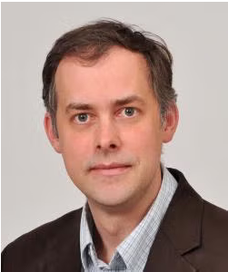
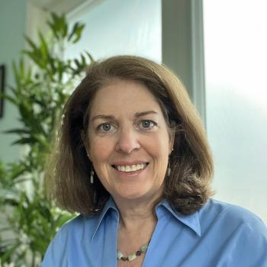
ISMRM & ISMRT ANNUAL MEETING & EXHIBITION
Honolulu, Hawai’i, USA
10-15 May 2025
…all good things come to an end
Thursday
17:45-18:45
Paul Lauterbur (†)
Mark Griswold
Kim Butts Pauly
STAY CONNECTED DURING THE MEETING:

Slide 24





ISMRM & ISMRT ANNUAL MEETING & EXHIBITION
Networking
Closing
Reception
THURSDAY, 15 MAY 2025
18:45-21:00 | Rooftop Garden, Level 4
STAY CONNECTED DURING THE MEETING:

Slide 25

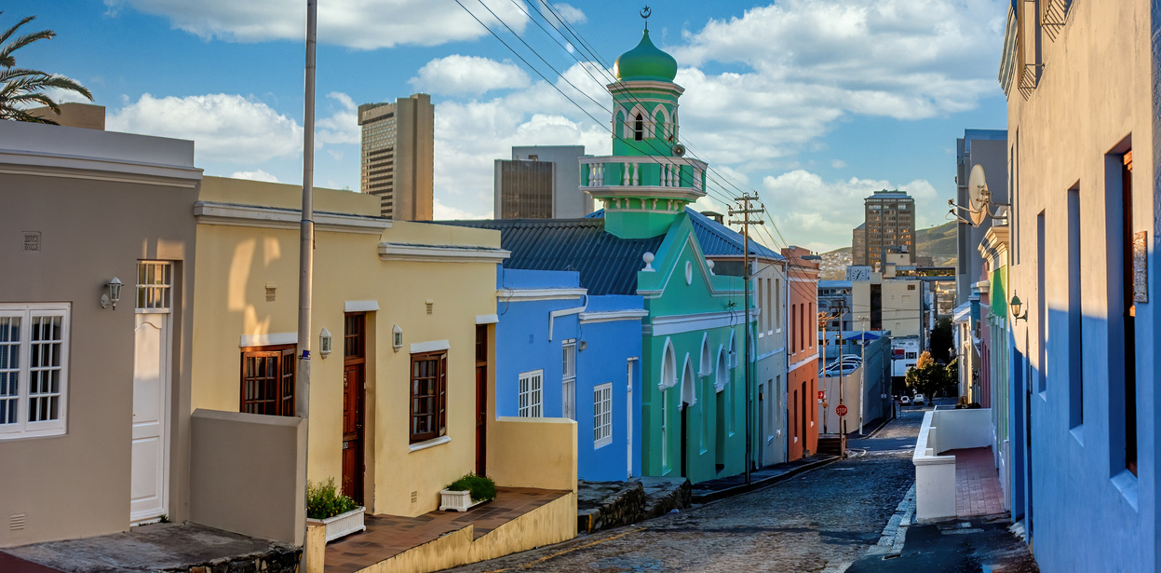
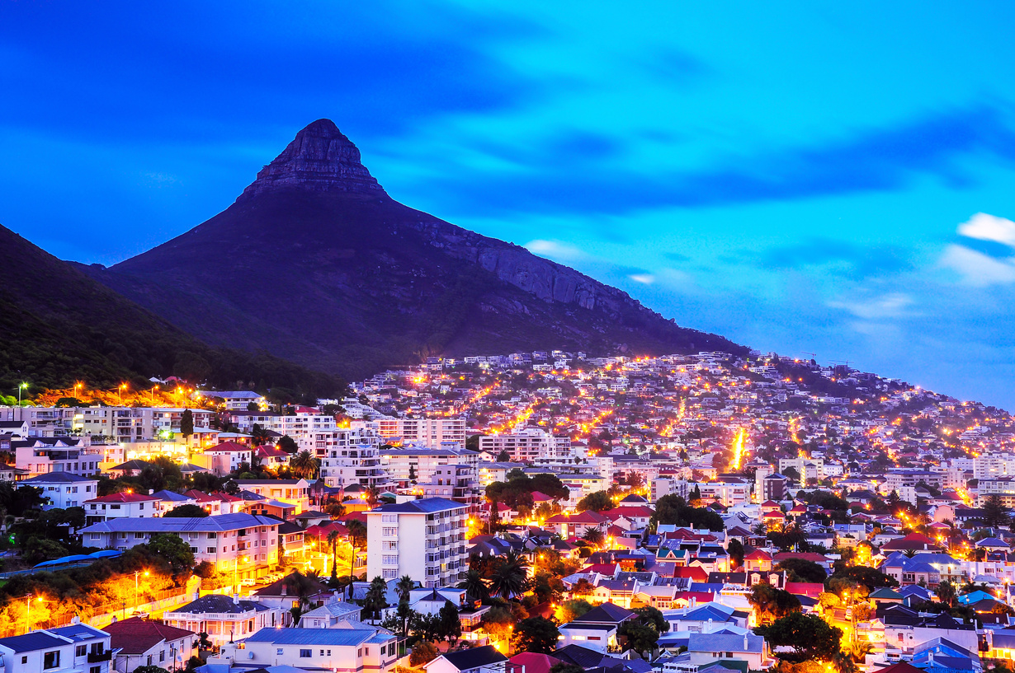
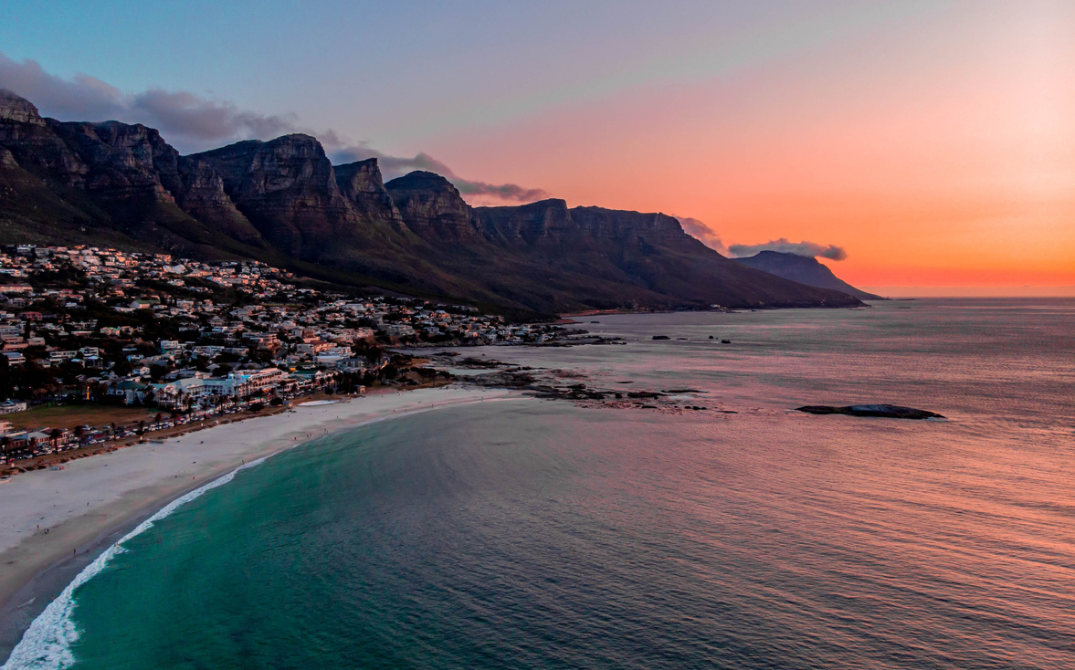
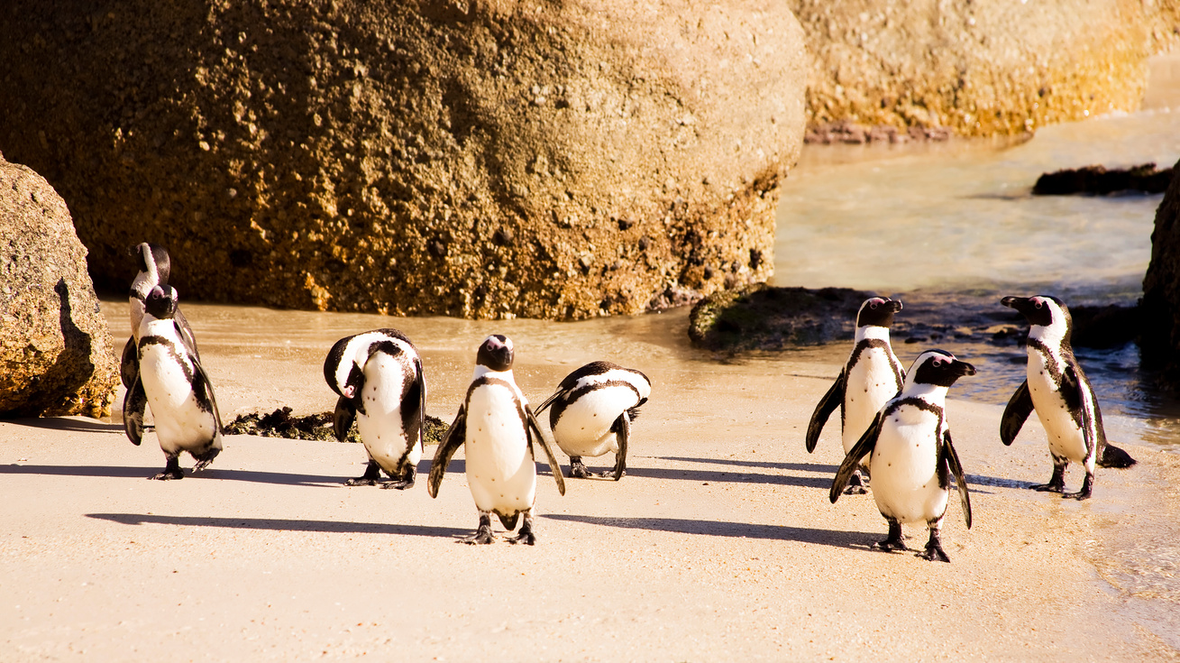

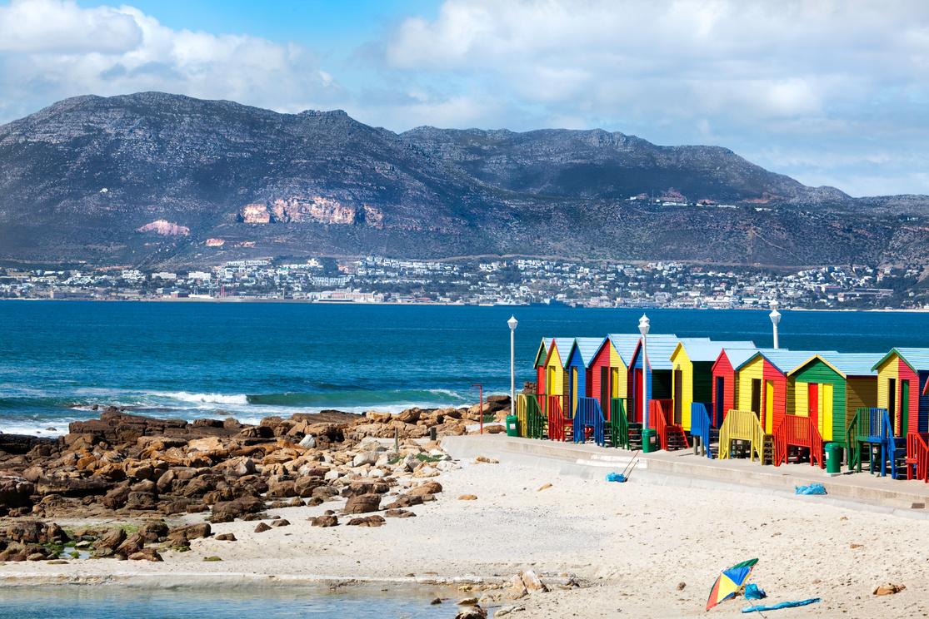
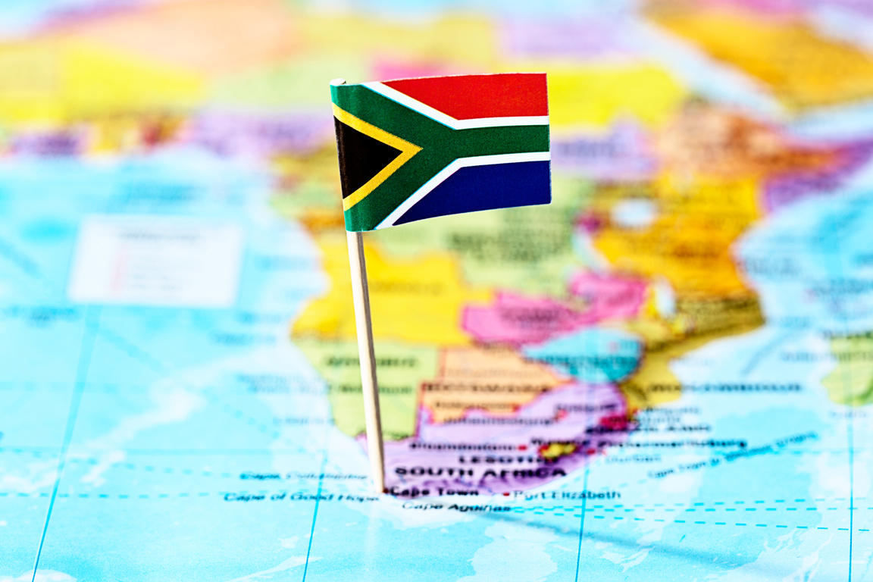
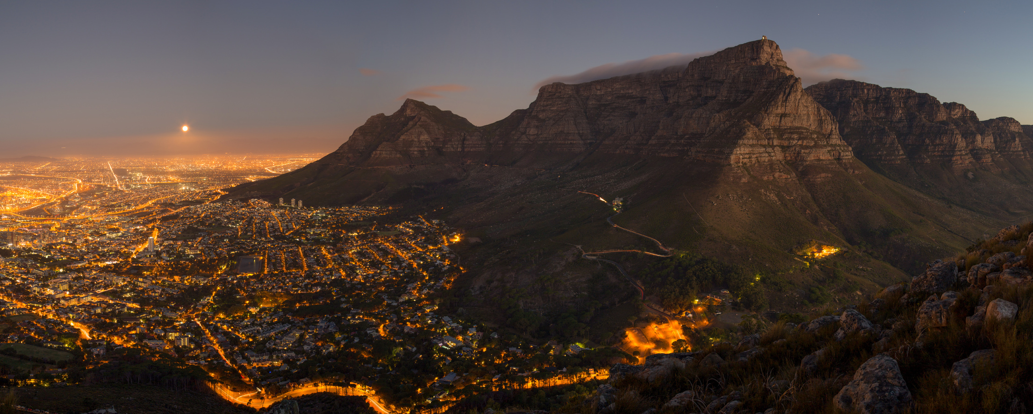
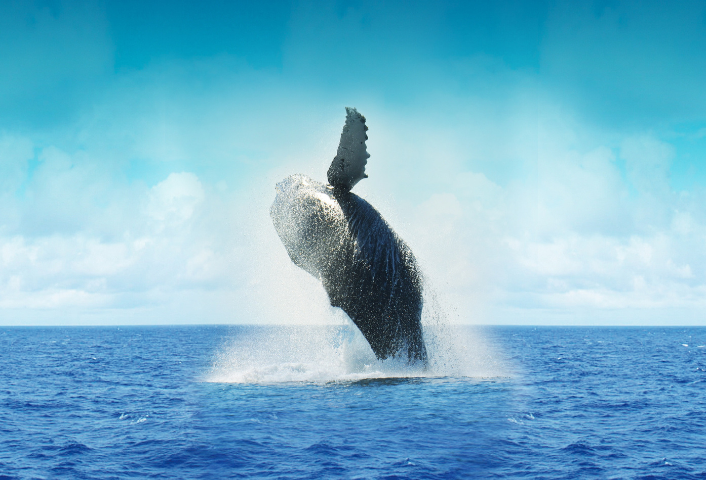

ISMRM & ISMRT
ANNUAL MEETING & EXHIBITION
Cape Town, South Africa
09-14 MAY 2026
Abstract Submission Deadline: 05 November 2025
CAPE TOWN is a vibrant, multicultural city known for its stunning landscapes, rich history, and dynamic culture.

Slide 26
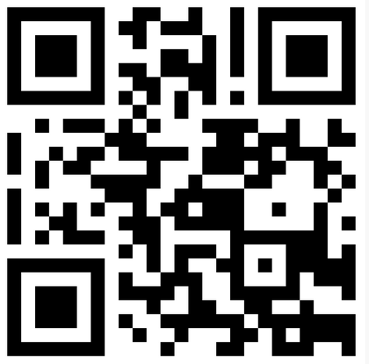
ISMRM & ISMRT ANNUAL MEETING & EXHIBITION
Honolulu, Hawai’i, USA
10-15 May 2025
Two more things
Check out:
Worldmap.ismrm.org
Contribute a video of your lab
STAY CONNECTED DURING THE MEETING:

Slide 27
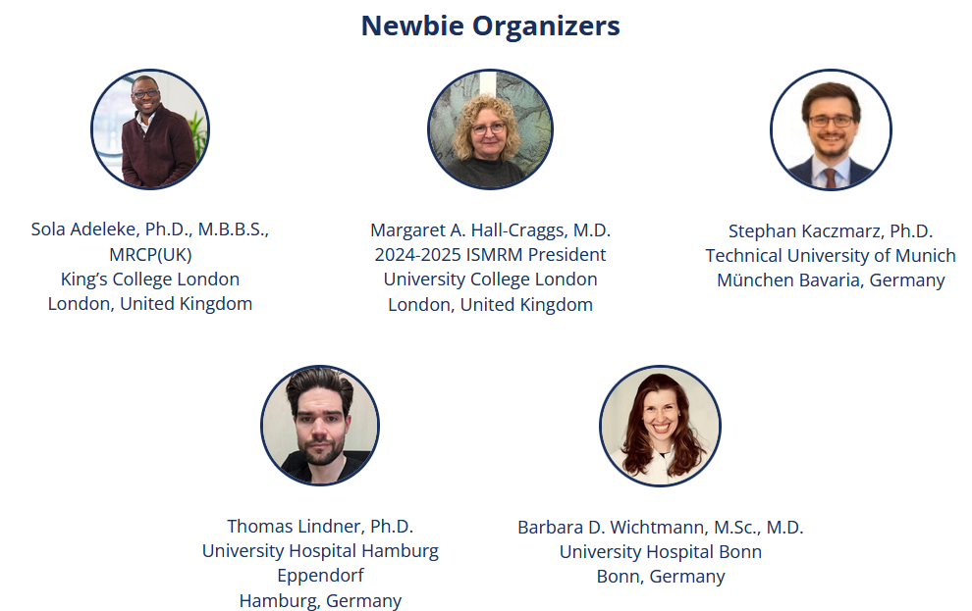
ISMRM & ISMRT ANNUAL MEETING & EXHIBITION
Honolulu, Hawai’i, USA
10-15 May 2025
We are looking forward to seeing you in Hawai’i
STAY CONNECTED DURING THE MEETING:

Slide 28
ISMRM & ISMRT ANNUAL MEETING & EXHIBITION
Honolulu, Hawai’i, USA
10-15 May 2025
Looking for CME?
Log into the ISMRM website to complete your evaluations and print out a certificate of credit or certificate of participation.
STAY CONNECTED DURING THE MEETING:

Slide 29
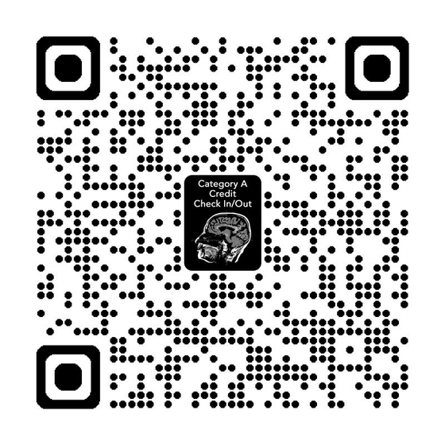
ISMRM & ISMRT ANNUAL MEETING & EXHIBITION
Honolulu, Hawai’i, USA
10-15 May 2025
Looking for CE/CPD?
Scan the QR code below or outside of the room and complete the linked form in order to be eligible for credits with CE or CPDnow. This replaces the scanning in and out of badges from previous years.
After the meeting, log into the ISMRT website to complete your evaluations and print out a certificate of credit or certificate of participation.
STAY CONNECTED DURING THE MEETING:

Slide 30
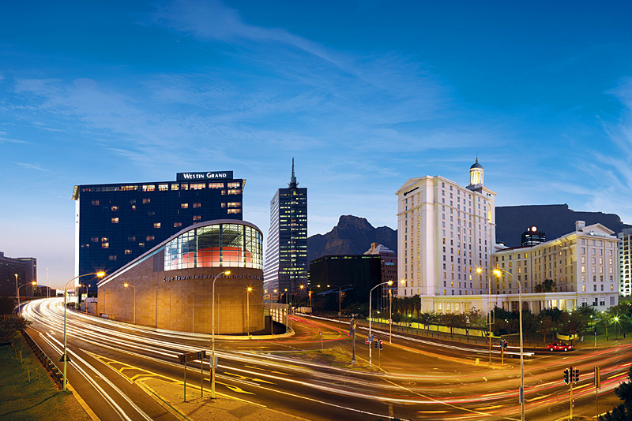
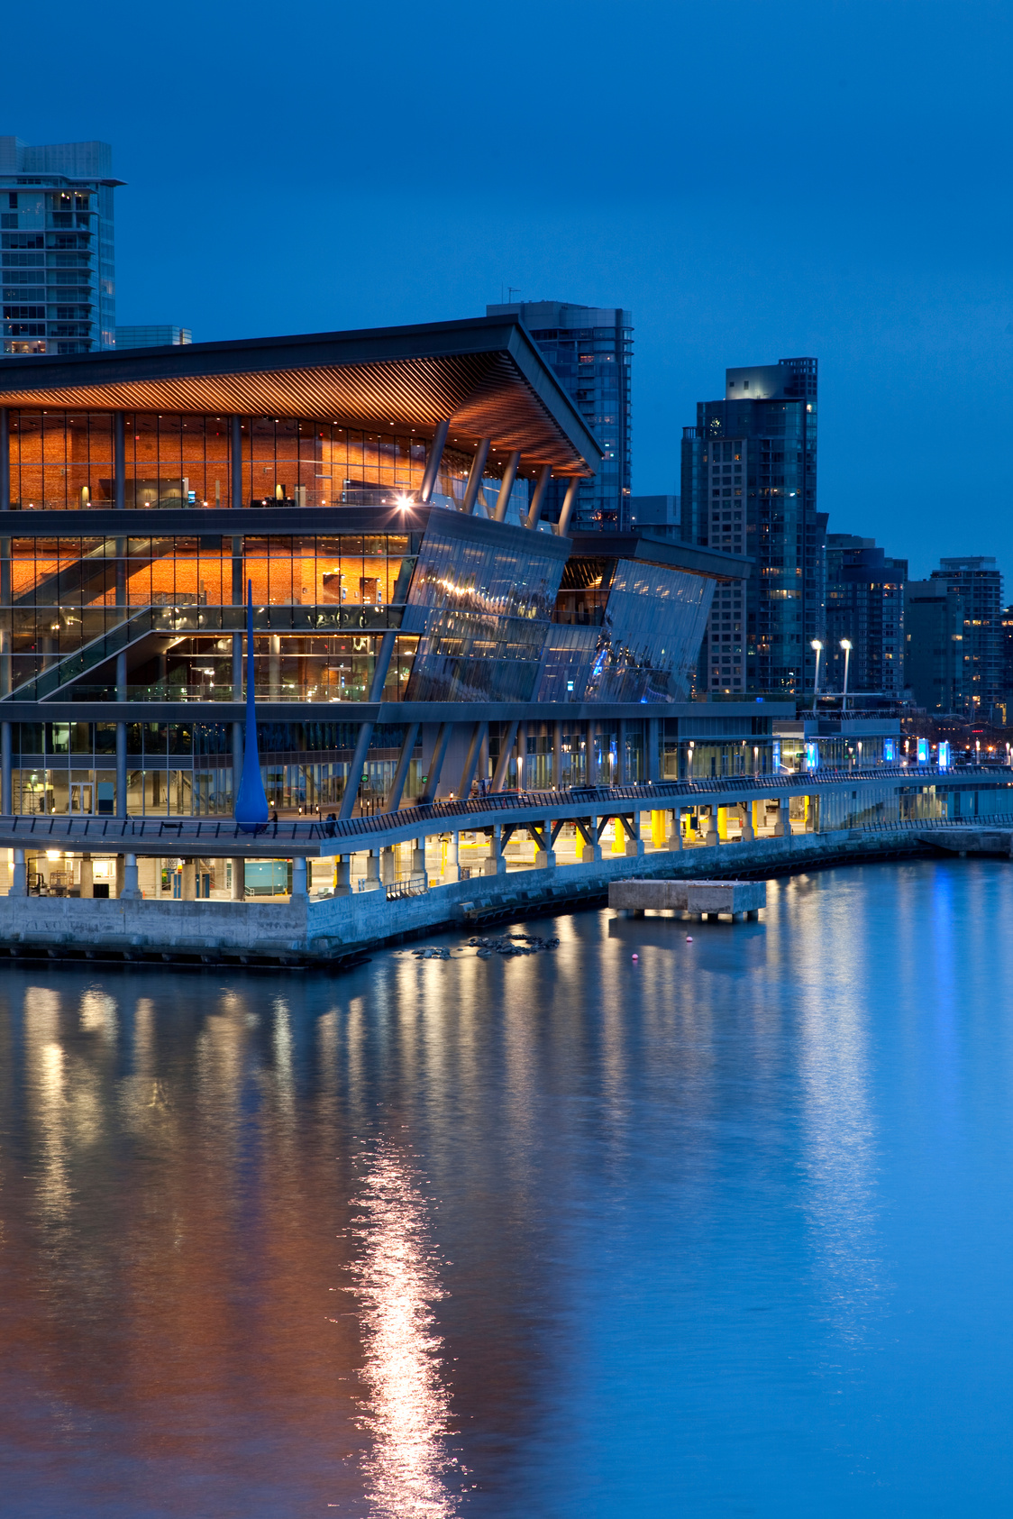
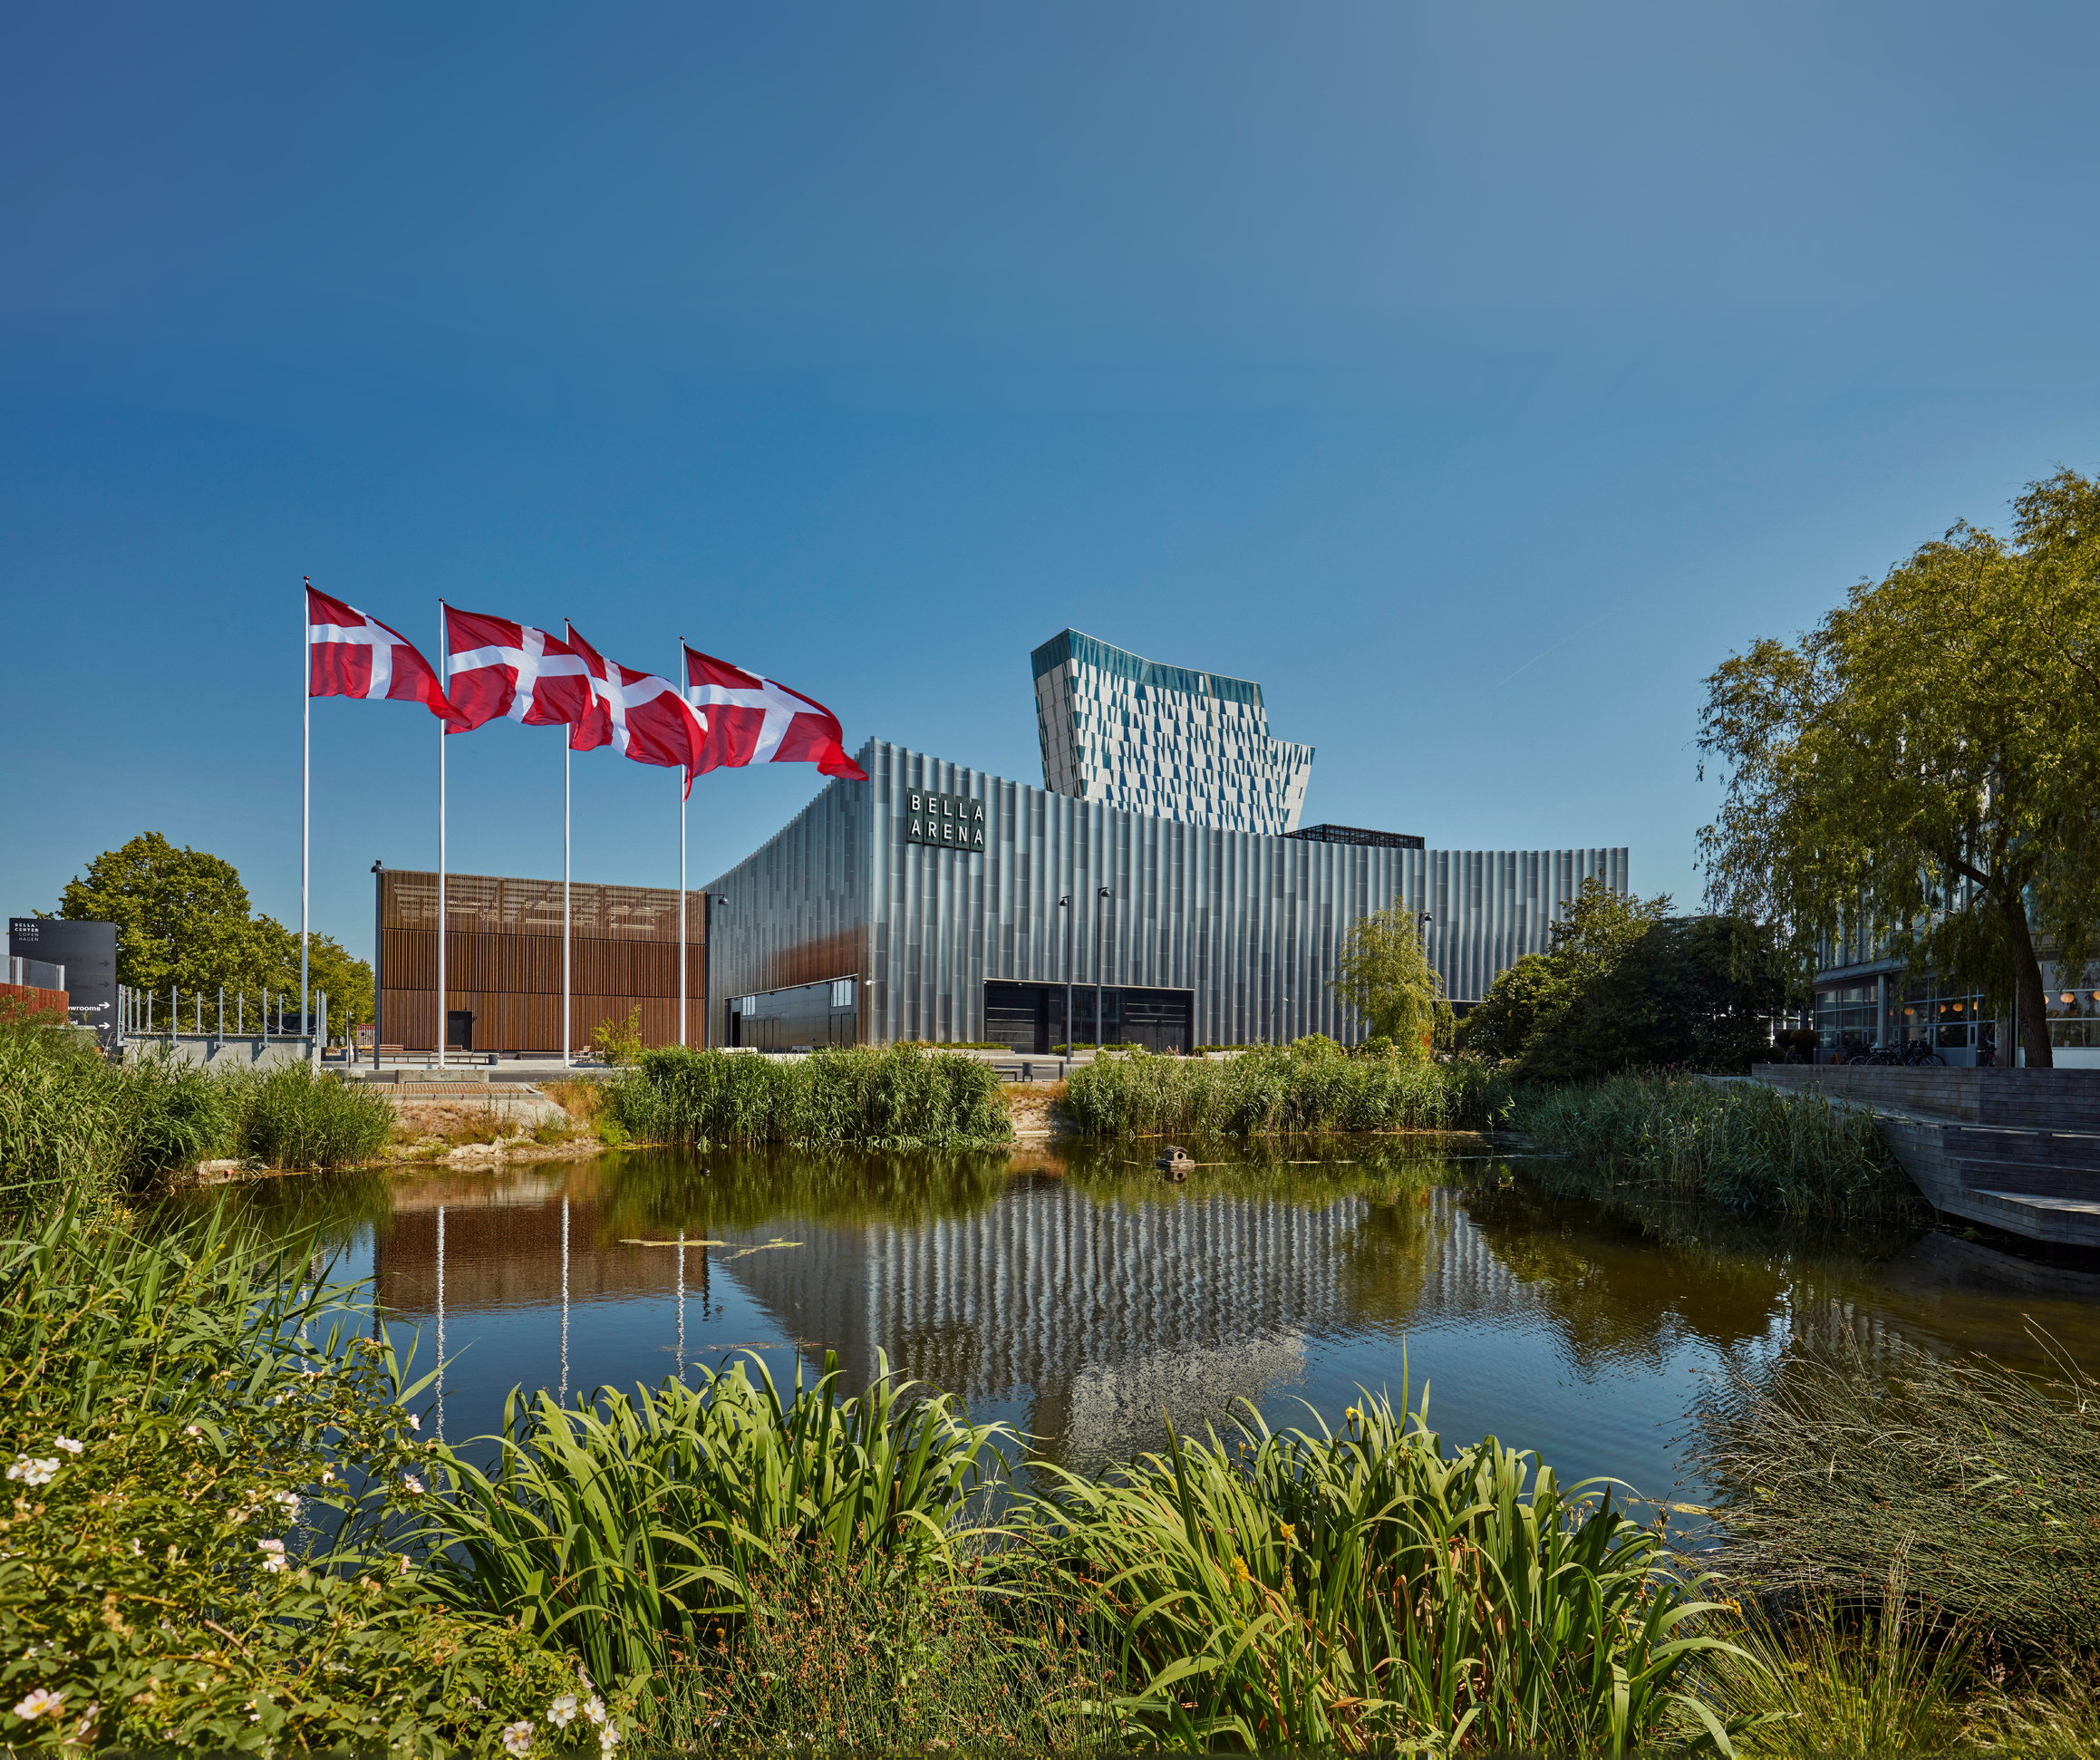
ISMRM & ISMRT
FUTURE ANNUAL MEETINGS
Cape Town, South Africa
Vancouver, BC, Canada
Copenhagen, Denmark
09-14 MAY
2026
08-13 MAY
2027
13-18 MAY
2028
STAY CONNECTED DURING THE MEETING:

Slide 31


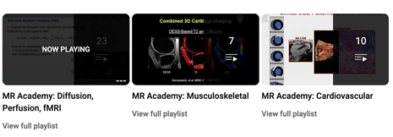
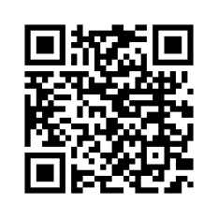
ISMRM & ISMRT ANNUAL MEETING & EXHIBITION
Honolulu, Hawai’i, USA
10-15 May 2025
New from the ISMRM Education Committee!
Nearly 1000 tagged/curated ISMRM Educational talks from 2015 to 2021 available for members to search by keyword.
THE
VAULT
COMMITTEE-SELECTED CONTENT POSTED TO YOUTUBE FOR FREE ACCESS.
*NEW* Includes “How To” content created by your 2023 ISMRM Education Committee.
Visit the MR Academy and see all that your colleagues have to offer!
STAY CONNECTED DURING THE MEETING:

Slide 32

ISMRM & ISMRT ANNUAL MEETING & EXHIBITION
Honolulu, Hawai’i, USA
10-15 May 2025
The ISMRM Research & Education Fund supports trainees in the field of magnetic resonance regardless of scientific discipline, geography, country of origin, and resources available.
Your generous donations have provided over 1,300+ stipends awarded annually! This allows recipients to attend the annual meeting and workshops.
Please continue to pay it forward and DONATE TODAY!
Make a donation of US$200.00 or more during the annual meeting and enjoy the on-site Donor Lounge.
Visit any ISMRM on-site registration desk or visit www.ismrm.org.
STAY CONNECTED DURING THE MEETING:

Slide 33


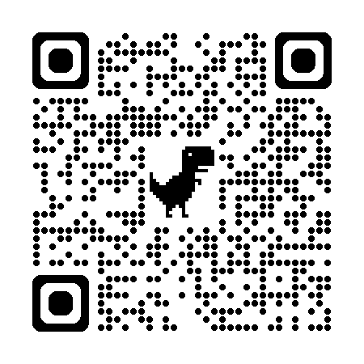

ISMRM & ISMRT ANNUAL MEETING & EXHIBITION
Honolulu, Hawai’i, USA
10-15 May 2025
Meetings
CONNECT WITH MR COLLEAGUES IN YOUR PART OF THE WORLD
STAY CONNECTED DURING THE MEETING:

Slide 34


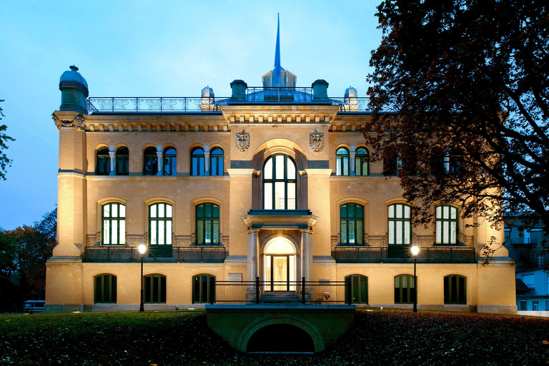

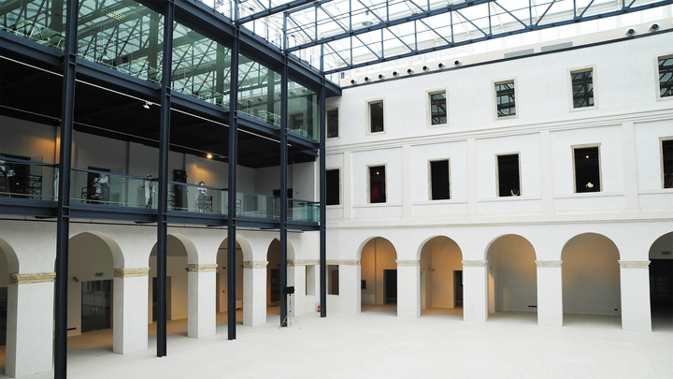
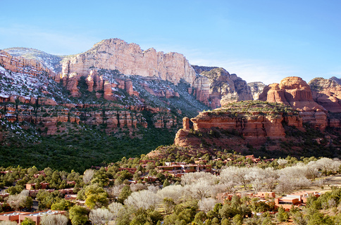
ISMRM
WORKSHOPS
ISMRM Workshop on Breast MRI: Technological Advances & Clinical Applications
13-15 September 2025 | Las Vegas, NV, USA
Abstract Submission Deadline: 12 June 2025
Visit
www.ismrm.org
for details & updates
ISMRM Workshop on MR Safety: From Science to Clinical Practice
24-26 September 2025 | Berlin, Germany
Abstract Submission Deadline: 13 June 2025
ISMRM Workshop on Unlocking the Potential of Prenatal MRI: Advances in Fetal Brain, Heart & Placenta Imaging
08-10 October 2025 | Washington, DC, USA
ISMRM Workshop on Frontiers in Metabolomics & Metabolomic Imaging in Medicine: Challenges & Opportunities
16-18 October 2025 | Padua, Italy
ISMRM Workshop on Data Sampling & Image Reconstruction
11-14 January 2026 | Sedona, AZ, USA
STAY CONNECTED DURING THE MEETING:

